Slide 1
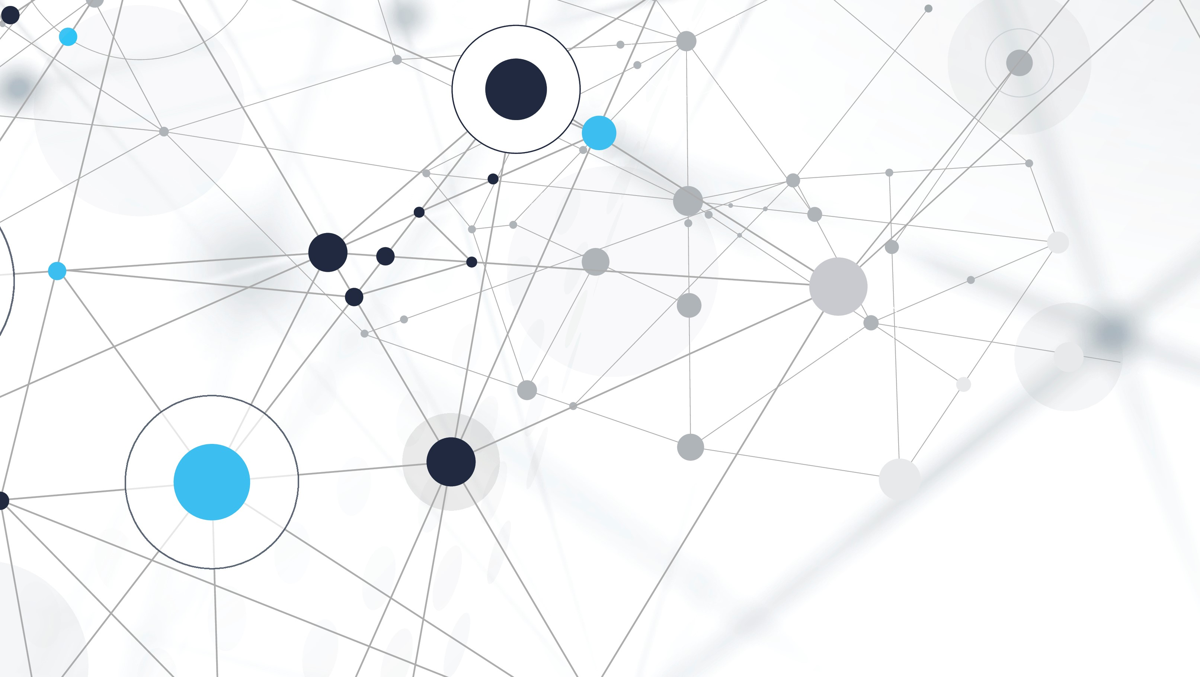
NLP Assignment
Robin Ramdin 25/02/2024

Slide 2
Slide Overview
Exploratory Data analysis (EDA)
Data pre-processing
Results & Findings
Project AIM
Future Improvements

Slide 3
Project Aim
Generate vector representations of text using different approaches to capture the clinical meanings.
Vector representation are typically called embeddings. Embeddings plays a crucial part in Natural Language Processing (NLP), it is the processing of converting text data into numerical representations which can be then fed into data science models.

Slide 4
Exploratory Data analysis (EDA)
ClinNotes.csv
MedicalConcepts.csv
Overview:
This csv file contains the clinicians notes of patients from three departments.
Purpose:
The bulk data is within this file as such, it will be used as training data.
Overview:
This csv file contains pairs of medical entities that are related to each other
Purpose:
This csv file will be used to evaluate the embeddings, medical term pairs should be closely related within an embedding space.
Note: The assessment of how close two terms are will be done using cosine similarity metric

Slide 5
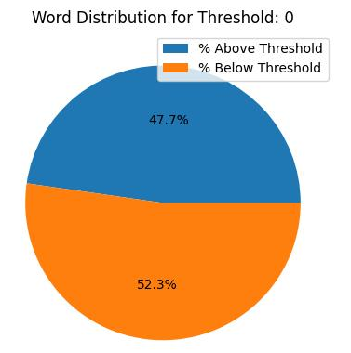
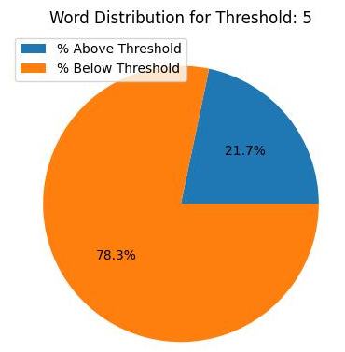
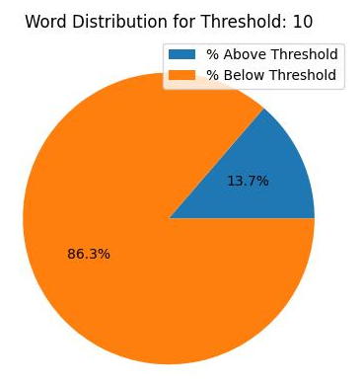
EDA - MedicalConcepts
To use the pairs in medicalconcepts for the evaluation, we first must check if they are present within the training data.
The frequency of each word in the evaluation data was counted within the training data. The pie charts on the right represent the percentage of words at different count thresholds.
From here we can observe that 52.3% of the words in evaluation data do not belong within the training data.
Since the models cannot be evaluated with unseen data, augmentation of the training data using the evaluation data is required.

Slide 6
EDA – Data Augmentation
To augment the training data new sentences created using the pairs within the evaluation data. Each new sentence followed the following format:
“clinician annotation identified {term1} and {term2} are closely related to each other”
Note: Due to time constraint, the sentences were manually created. A better approach would be to use a transformer-based model to generate the new sentences.

Slide 7
Data pre-processing
For the preprocessing personal information was substituted with general terms. In the example provided below, the encrypted patient’s name was replaced with their gender. This was done to prevent the association of a specific name to a disease.
“Mr. ABC has dementia” → “man has dementia”
This substitution was also performed on the doctors, again to prevent any form of bias.
The clinical notes contained artifacts which were removed, all texts were set to the lowercase and extra whitespaces were removed.

Slide 8
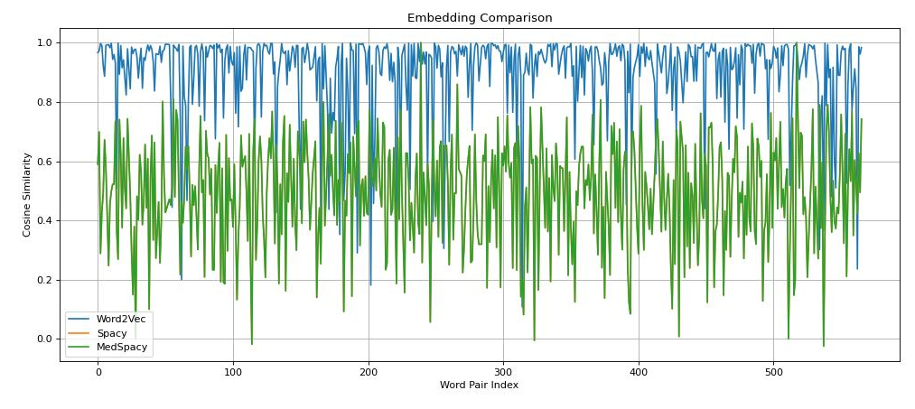
Results & findings
We utilised three models to generate the embeddings; Word2Vec, Spacy & MedSpacy.
Cosine similarity was used measure the distance between each word pair in the evaluation data for each embedding.
From the plot, we observe Word2Vec embeddings on the evaluation data to be closer than Spacy/MedSpacy.
The embeddings generated from Spacy and MedSpacy overlap each other in the plot.
Based on our results Word2Vec would be the best embedding model to use.
Note: For cosine similarity metric, close vectors get a value closer to 1, while vectors far away get a value closer to zero

Slide 9
Future Improvements
In this exercise we only used the tokenizers from the Spacy libraries, it does however come with multiple useful elements within its pipeline which should be explored for the entity recognition.
As mentioned before, data augmentation should utilize a transformer-based model to create more meaningful content and abstract out the need for hard coded strings.
In this exercise only three models were used, however there are more model available which are worth trying. Models focusing on medical data will be particularly useful.
Although Word2Vec showcased better performance than the other libraries, it does have its own limitation, particularly when it comes to unseen words. Therefore acquiring a larger ClinNotes dataset is crucial in the performance of the embedding models.

